Slide 1
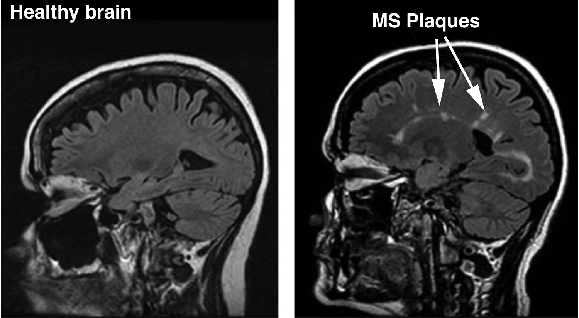
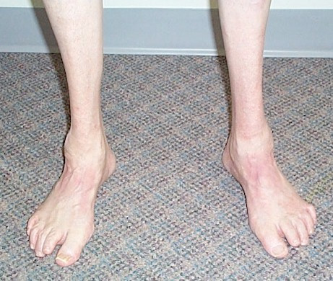
Neurological Disorders Lesson 2.5
What can go wrong?

Slide 2
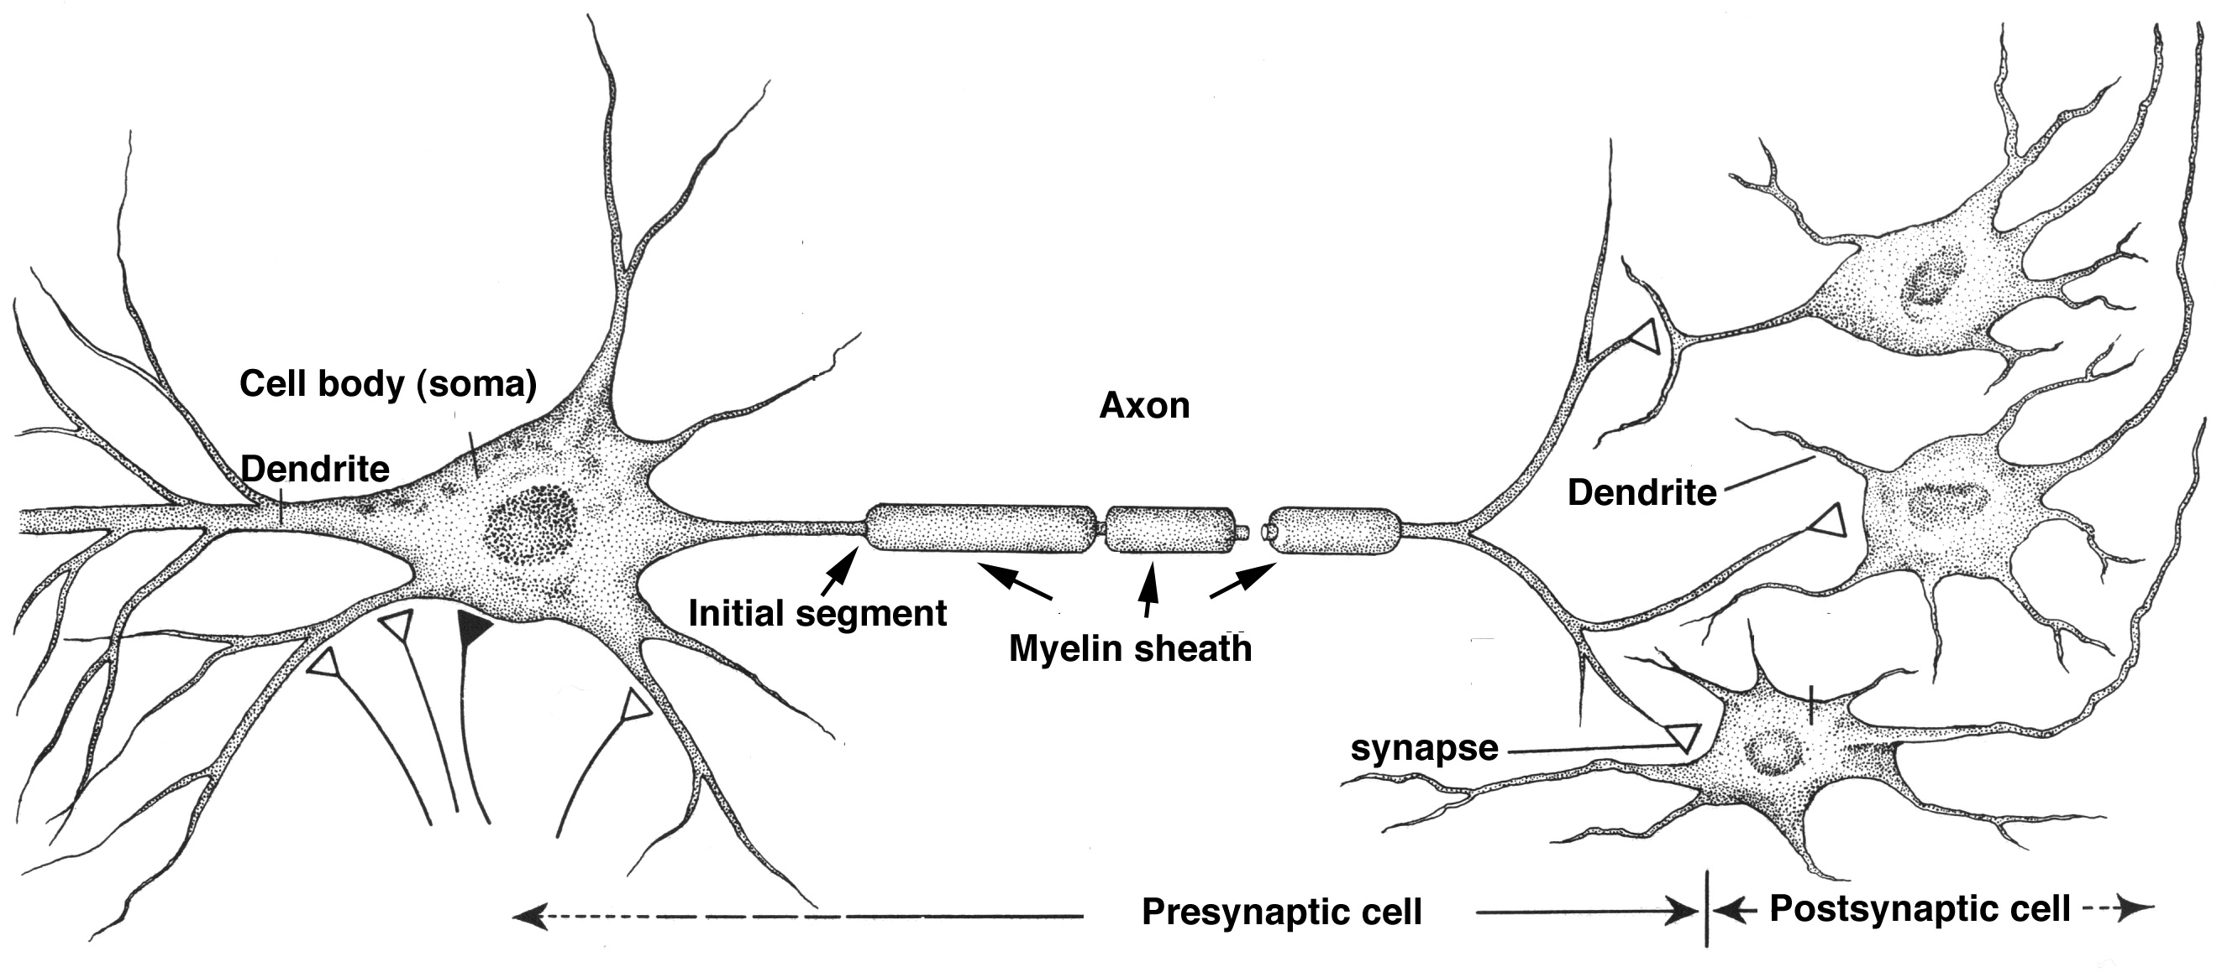
Do Now: What can go wrong?
1. _____________
4. _______________
2. ______________
5. _______________
3. _____________
6. _____________

Slide 3
Quick Review – Neuron Parts & Function
4. Axon – send signals electrically and provides transportation route
1. _____________
4. _______________
1. Dendrites – receive signals
2. Cell Body – maintains cell life
2. ______________
5. Myelin – insulate axon
5. _______________
3. Initial Segment – process inputs
3. _____________
6. _____________
6. Synapse – send signals chemically

Slide 4
What can go wrong?
4. Axon – send signals electrically and provides transportation route
1. Dendrites – receive signals
2. Cell Body – maintains cell life
5. Myelin – insulate axon
3. Initial Segment – process inputs
6. Synapse – send signals chemically

Slide 5
Gabby – Congenital analgesia
Normal Patient
Gabby
X
X

Slide 6
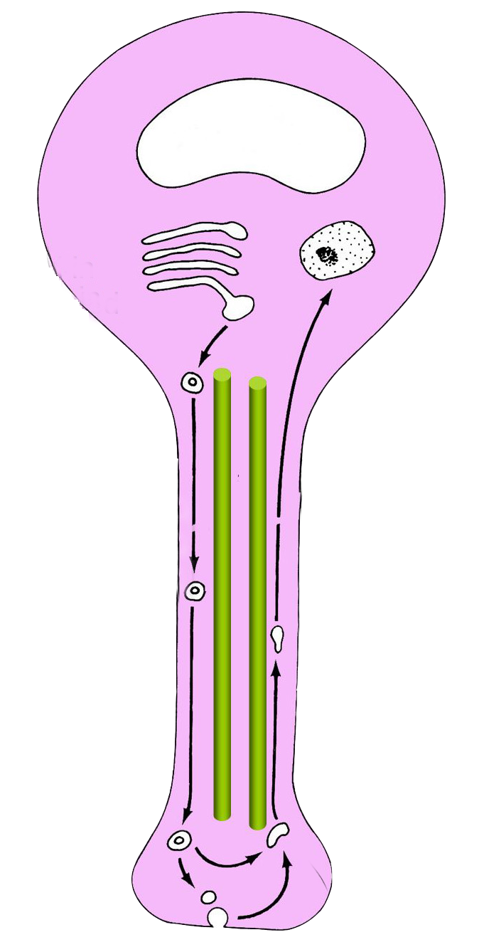
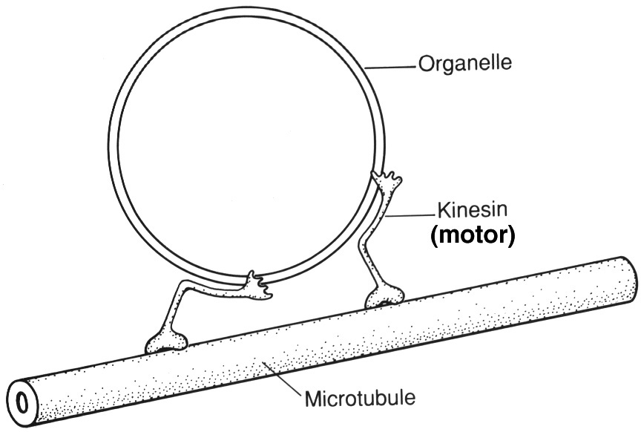
Mitchell – Hereditary Spastic Paraplegia (HSP)
nucleus
HSP defects with Kinesin
synapse

Slide 7
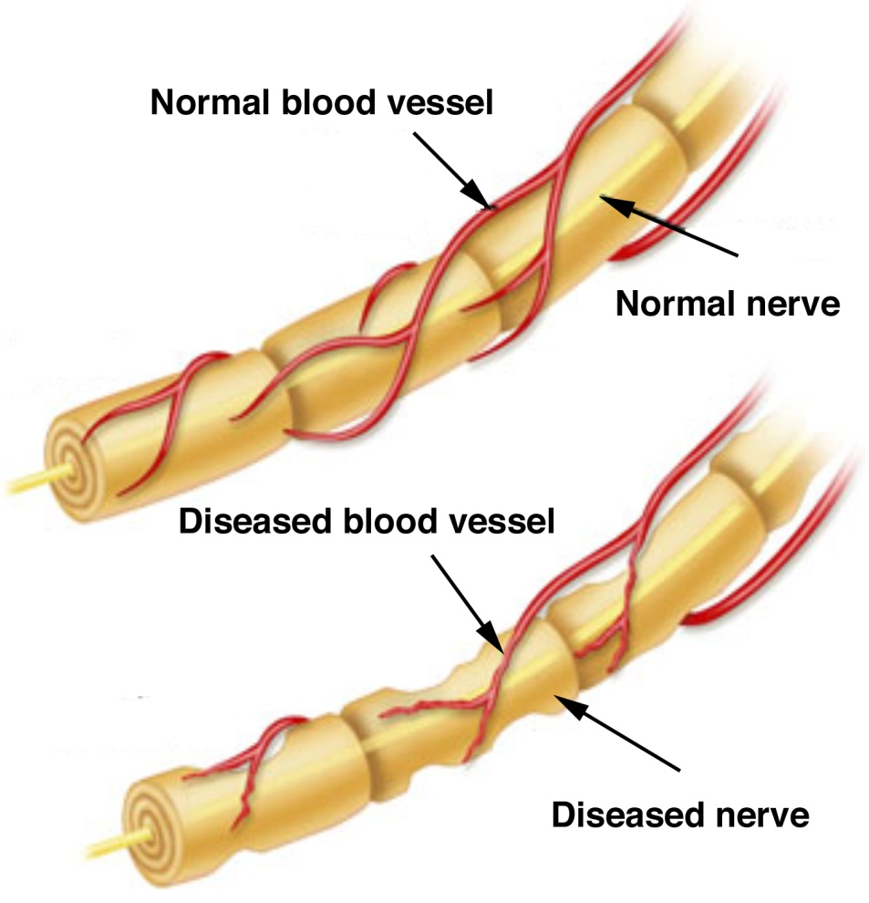
Albert – Diabetic Neuropathy

Slide 8
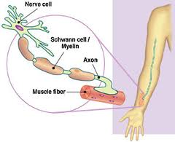
Allison – Charcot-Marie Tooth Disease (CMTD)
Champagne Legs
Defects with Peripheral Myelin

Slide 9
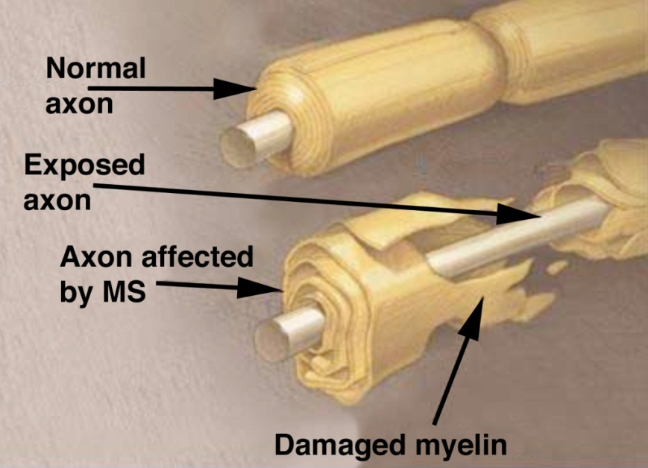
Maria – Multiple Sclerosis (MS)

Slide 10
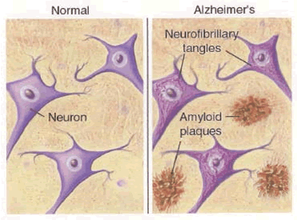
Yumiko – Alzheimer’s Disease (AD)

